Slide 1
File

Slide 2
Motivations
Data stored in a text file is represented in human-readable form.
Data stored in a binary file is represented in binary form. You cannot read binary files. They are designed to be read by programs.
For example, Java source programs are stored in text files and can be read by a text editor
But Java classes are stored in binary files and are read by the JVM.
The advantage of binary files is that they are more efficient to process than text files.

Slide 3
Text File vs. Binary File
Although it is not technically precise and correct, you can imagine that a text file consists of a sequence of characters
A binary file consists of a sequence of bits.
For example, the decimal integer 199 is stored as the sequence of three characters: '1', '9', '9' in a text file and
the same integer is stored as a byte-type value C7 in a binary file, because decimal 199 equals to hex C7.

Slide 4
File
A File object encapsulates the properties of a file or a path, but does not contain the methods for reading/writing data from/to a file.
File a = new File(“filename");

Slide 5
Text I/O
In order to perform I/O, you need to create objects using appropriate Java I/O classes. The objects contain the methods for reading/writing data from/to a file.
This section introduces how to read/write strings and numeric values from/to a text file using the Scanner and PrintWriter classes.

Slide 6
Writing Data Using PrintWriter
WriteData
Run

Slide 7
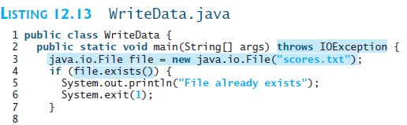
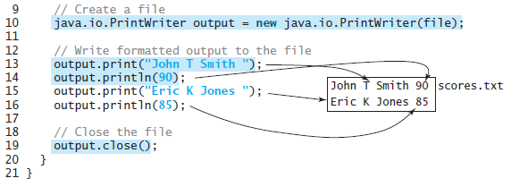

Slide 8
Try-with-resources
Programmers often forget to close the file. JDK 7 provides the followings new try-with-resources syntax that automatically closes the files.
try (declare and create resources) {
Use the resource to process the file;
}
WriteDataWithAutoClose
Run

Slide 9
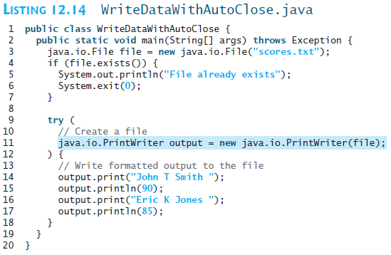

Slide 10
Reading Data Using Scanner
ReadData
Run

Slide 11
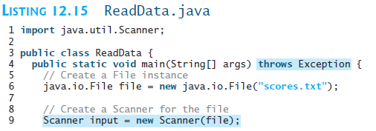
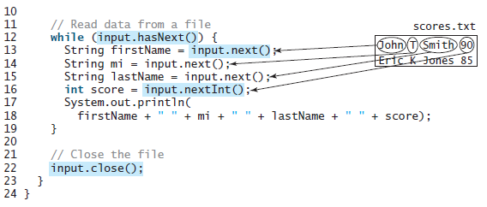

Slide 12
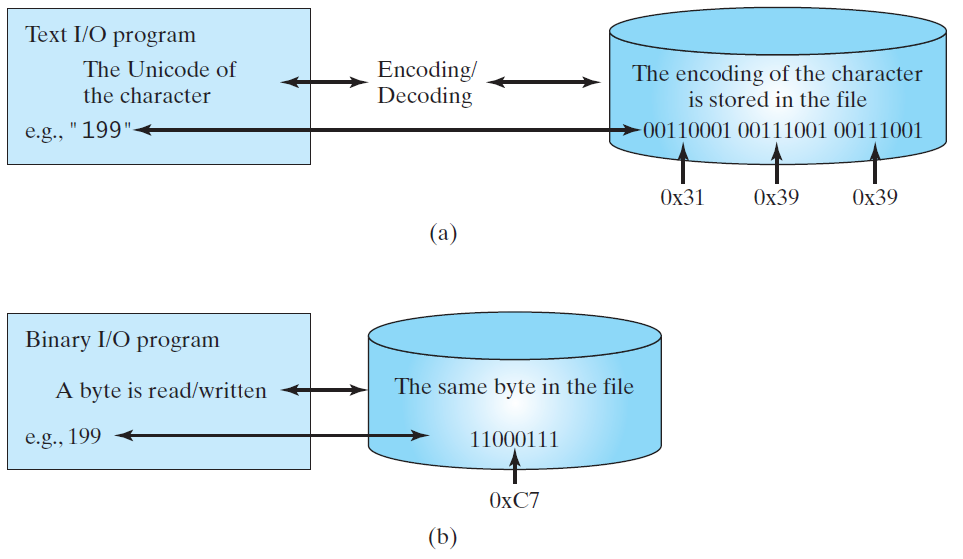
Binary I/O
Text I/O requires encoding and decoding. The JVM converts a Unicode to a file specific encoding when writing a character and coverts a file specific encoding to a Unicode when reading a character. Binary I/O does not require conversions. When you write a byte to a file, the original byte is copied into the file. When you read a byte from a file, the exact byte in the file is returned.

Slide 13
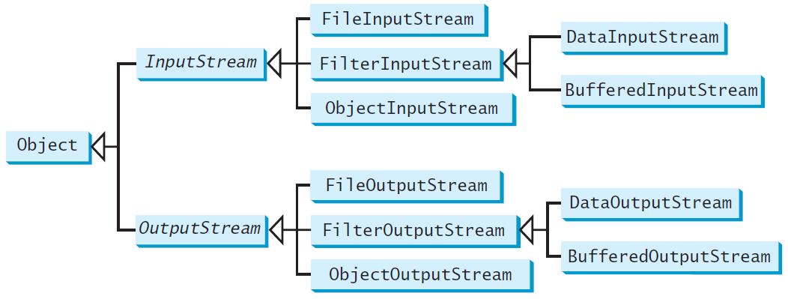
Binary I/O Classes

Slide 14
InputStream
The value returned is a byte as an int type.

Slide 15
OutputStream
The value is a byte as an int type.

Slide 16
FileInputStream/FileOutputStream
FileInputStream/FileOutputStream associates a binary input/output stream with an external file. All the methods in FileInputStream/FileOuptputStream are inherited from its superclasses.

Slide 17
FileInputStream
To construct a FileInputStream, use the following constructors:
public FileInputStream(String filename)
public FileInputStream(File file)
A java.io.FileNotFoundException would occur if you attempt to create a FileInputStream with a nonexistent file.

Slide 18
FileOutputStream
To construct a FileOutputStream, use the following constructors:
public FileOutputStream(String filename)
public FileOutputStream(File file)
public FileOutputStream(String filename, boolean append)
public FileOutputStream(File file, boolean append)
If the file does not exist, a new file would be created. If the file already exists, the first two constructors would delete the current contents in the file. To retain the current content and append new data into the file, use the last two constructors by passing true to the append parameter.
TestFileStream
Run

Slide 19
FilterInputStream/FilterOutputStream
Filter streams are streams that filter bytes for some purpose. The basic byte input stream provides a read method that can only be used for reading bytes. If you want to read integers, doubles, or strings, you need a filter class to wrap the byte input stream. Using a filter class enables you to read integers, doubles, and strings instead of bytes and characters. FilterInputStream and FilterOutputStream are the base classes for filtering data. When you need to process primitive numeric types, use DatInputStream and DataOutputStream to filter bytes.

Slide 20
DataInputStream/DataOutputStream
DataInputStream reads bytes from the stream and converts them into appropriate primitive type values or strings.
DataOutputStream converts primitive type values or strings into bytes and output the bytes to the stream.

Slide 21
Characters and Strings in Binary I/O
A Unicode consists of two bytes. The writeChar(char c) method writes the Unicode of character c to the output. The writeChars(String s) method writes the Unicode for each character in the string s to the output.
Why UTF-8? What is UTF-8?
UTF-8 is a coding scheme that allows systems to operate with both ASCII and Unicode efficiently. Most operating systems use ASCII. Java uses Unicode. The ASCII character set is a subset of the Unicode character set. Since most applications need only the ASCII character set, it is a waste to represent an 8-bit ASCII character as a 16-bit Unicode character. The UTF-8 is an alternative scheme that stores a character using 1, 2, or 3 bytes. ASCII values (less than 0x7F) are coded in one byte. Unicode values less than 0x7FF are coded in two bytes. Other Unicode values are coded in three bytes.

Slide 22
Using DataInputStream/DataOutputStream
Data streams are used as wrappers on existing input and output streams to filter data in the original stream. They are created using the following constructors:
public DataInputStream(InputStream instream)
public DataOutputStream(OutputStream outstream)
The statements given below create data streams. The first statement creates an input stream for file in.dat; the second statement creates an output stream for file out.dat.
DataInputStream infile =
new DataInputStream(new FileInputStream("in.dat"));
DataOutputStream outfile =
new DataOutputStream(new FileOutputStream("out.dat"));
TestDataStream
Run

Slide 24
Checking End of File
Order and Format
CAUTION: You have to read the data in the same order and same format in which they are stored. For example, since names are written in UTF-8 using writeUTF, you must read names using readUTF.
TIP: If you keep reading data at the end of a stream, an EOFException would occur. So how do you check the end of a file? You can use input.available() to check it. input.available() == 0 indicates that it is the end of a file.

Slide 25
BufferedInputStream/ BufferedOutputStream
Using buffers to speed up I/O
BufferedInputStream/BufferedOutputStream does not contain new methods. All the methods BufferedInputStream/BufferedOutputStream are inherited from the InputStream/OutputStream classes.

Slide 26
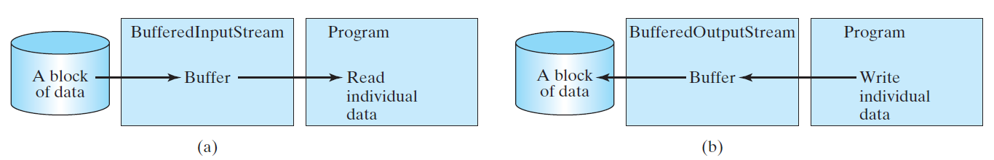
Constructing BufferedInputStream/BufferedOutputStream
// Create a BufferedInputStream
public BufferedInputStream(InputStream in)
public BufferedInputStream(InputStream in, int bufferSize)
// Create a BufferedOutputStream
public BufferedOutputStream(OutputStream out)
public BufferedOutputStream(OutputStreamr out, int bufferSize)

Slide 27
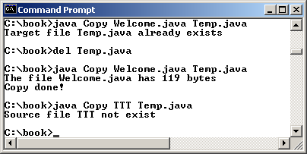
Case Studies: Copy File
This case study develops a program that copies files. The user needs to provide a source file and a target file as command-line arguments using the following command:
java Copy source target
The program copies a source file to a target file and displays the number of bytes in the file. If the source does not exist, tell the user the file is not found. If the target file already exists, tell the user the file already exists.
Copy
Run

Slide 30
Object I/O
Optional
DataInputStream/DataOutputStream enables you to perform I/O for primitive type values and strings. ObjectInputStream/ObjectOutputStream enables you to perform I/O for objects in addition for primitive type values and strings.

Slide 31
ObjectInputStream
ObjectInputStream extends InputStream and implements ObjectInput and ObjectStreamConstants.

Slide 32
ObjectOutputStream
ObjectOutputStream extends OutputStream and implements ObjectOutput and ObjectStreamConstants.

